Slide 1
DIABETES PREDICTION USING SQL
CReated by
Venkatesh polisetti

Slide 2
DESCRIPTION
Diabetes prediction analysis aims to utilize data analytics techniques to forecast the likelihood of an individual developing diabetes or to anticipate the progression of the disease based on various contributing factors. This predictive analysis process typically involves several key steps
Data Collection
Data Pre-processing
Model Development
Model Deployment

Slide 3
TOOLS USED IN THIS PREDICTION
Throughout the entire process, SQL is utilized for data manipulation, feature engineering, model development, and deployment, leveraging its capabilities for querying and analysing structured data stored in a relational database. Additionally, SQL-based analytics platforms or frameworks may provide tools and functionalities specifically designed for predictive modeling tasks, facilitating the analysis of diabetes prediction data. MySQL Workbench 8.0 CE enables you to create and execute SQL queries to interact with stored data.

Slide 4
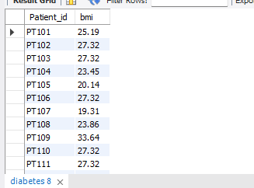
Retrieve the Patient_id and bmi of all patients.
Select Patient_id, bmi from diabetes;

Slide 5
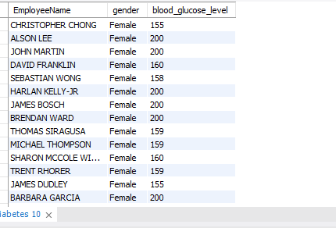
Select all female patients who has Blood glucose level greater than 150.
Select EmployeeName,gender,blood_glucose_level from diabetes where gender='Female' and blood_glucose_level>150;

Slide 6
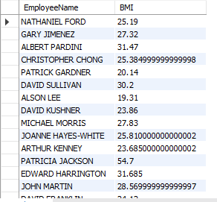
Calculate the average BMI of patients.
Select EmployeeName, avg(bmi) as BMI from diabetes GROUP BY EmployeeName;

Slide 7
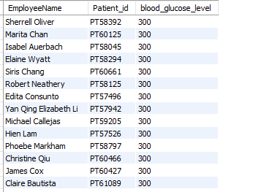
List patients in descending order of blood glucose levels.
Select EmployeeName,Patient_id,blood_glucose_level from diabetes order by blood_glucose_level desc;

Slide 8
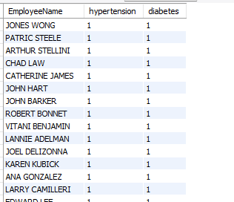
Find patients who have hypertension and diabetes.
Select EmployeeName, hypertension, diabetes from diabetes where hypertension=1 and diabetes =1 ;

Slide 9
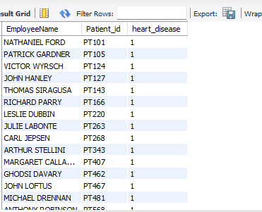
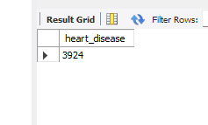
Determine the number of patients with heart disease.
Select EmployeeName , Patient_id, heart_disease from diabetes where heart_disease=1;
Select count(*) as heart_disease from diabetes where heart_disease=1;

Slide 10
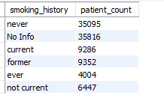
Group patients by smoking history and count how many smokers and non smokers there are.
Select smoking_history, count(*) as patient_count from diabetes group by smoking_history;

Slide 11
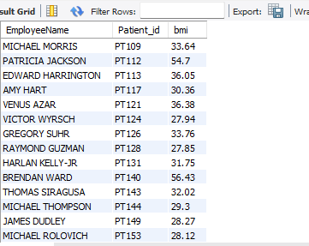
Retrieve the Patient_ids of patients who have a BMI greater than the average BMI.
Select EmployeeName, Patient_id ,bmi from diabetes where bmi>(Select avg(bmi) from diabetes);

Slide 12
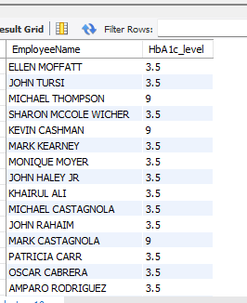
Find the patient with the highest HbA1c level and the patient with the lowest HbA1clevel.
Select EmployeeName,HbA1c_level from diabetes where HbA1c_level=(select max(HbA1c_level) from diabetes) or HbA1c_level= (select min(HbA1c_level) from diabetes);

Slide 13
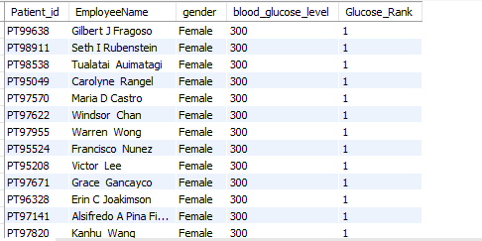
Rank patients by blood glucose level within each gender group.
Select Patient_id, EmployeeName,gender, blood_glucose_level, rank() over(partition by gender order by blood_glucose_level desc) as Glucose_Rank from diabetes;

Slide 14
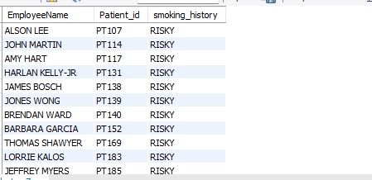
Update the smoking history of patients who has blood_glucose_level>180 to “RISKY."
update diabetes set smoking_history ='RISKY' WHERE blood_glucose_level>180;select EmployeeName,Patient_id,smoking_history from diabetes where smoking_history='risky';

Slide 15
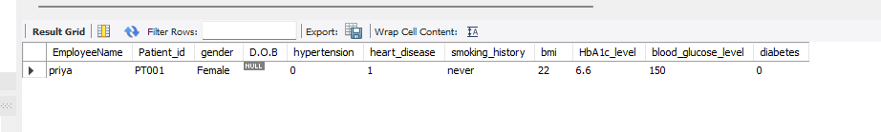
Insert a new patient into the database with sample data.
insert into diabetes (EmployeeName,Patient_id,gender,hypertension,heart_disease,smoking_history,bmi,HbA1c_level,blood_glucose_level,diabetes) values('priya','PT001','Female',0,1,'never',22,6.6,150,0); select * from diabetes where Patient_id='PT001';

Slide 16
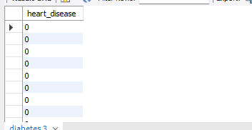
Delete all patients with heart disease from the database.
delete from diabetes where heart_disease=1;select heart_disease from diabetes;

Slide 17
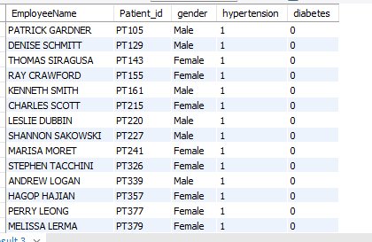
Find patients who have hypertension but not diabetes using the EXCEPT operator.
Select EmployeeName,Patient_id,gender,hypertension,diabetes from diabetes where hypertension=1 except Select EmployeeName,Patient_id,gender,hypertension,diabetes from diabetes where diabetes=1;

Slide 18
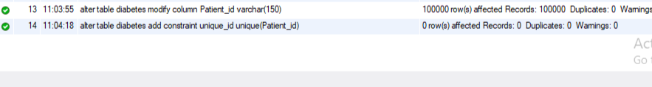
Define a unique constraint on the "patient_id" column to ensure its values are unique.
alter table diabetes modify column Patient_id varchar(150); alter table diabetes add constraint unique_id unique(Patient_id);

Slide 19
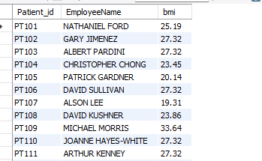
Create a view that displays the Patient_ids, EmployeeName, and BMI of patients.
create view Patient_Information as select Patient_id,EmployeeName,bmi from diabetes ; select * from Patient_Information;

Slide 20
Suggest improvements in the database schema to reduce data redundancy and improve data integrity.
Applying master data
Normalizing databases
Remove unused data
Data integration
Regular Maintenance
Avoiding Denormalization

Slide 21
Explain how you can optimize the performance of SQL queries on this dataset.
Minimize the use of wildcard characters
Increase Query Performance with Indexes
Optimize the database design
Use query optimization tools
Monitor query performance
Optimizing SQL queries for faster performance is an important step in ensuring that database applications run efficiently.

Slide 22
CONCLUSION
Important information on the demographics of patients and health outcomes are obtained from this diabetes prediction study. The greatest blood glucose level ever measured was 300 and heart disease for about 3924 persons. Persons who has diabetes with smoking habit is around 9286. Furthermore , the bulk of patients who previously smoked are 9352 . We can suggest if we take care of our health in serious way there will be some more time on this world
SQL-based diabetes prediction analysis offers a powerful framework for leveraging data-driven insights to support personalized healthcare interventions, improve patient outcomes, and contribute to population health management efforts.

Slide 23

THANK YOU

